Slide 1
OpenAPI autocompletion with Large Language Models
Bohdan Petryshyn
Supervised by Assoc. Professor Mantas Lukoševičius

Slide 2
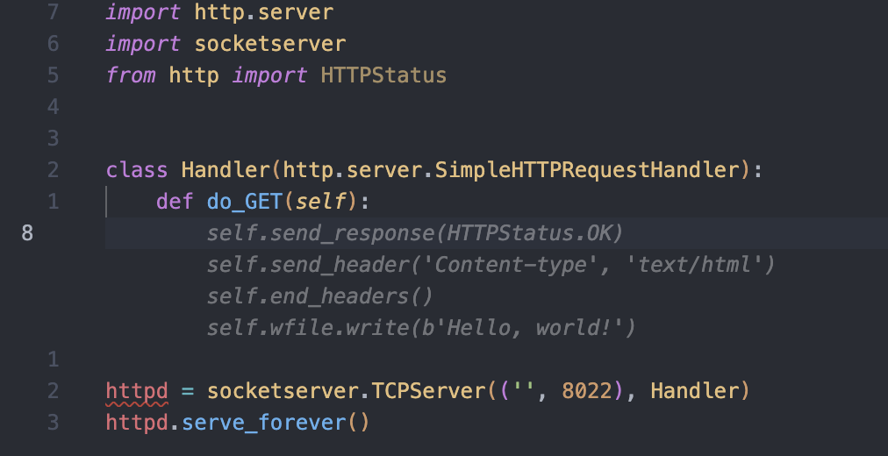
Terms - Code completion
Symbol-level autocompletion vs Snippet-level autocompletion

Slide 3
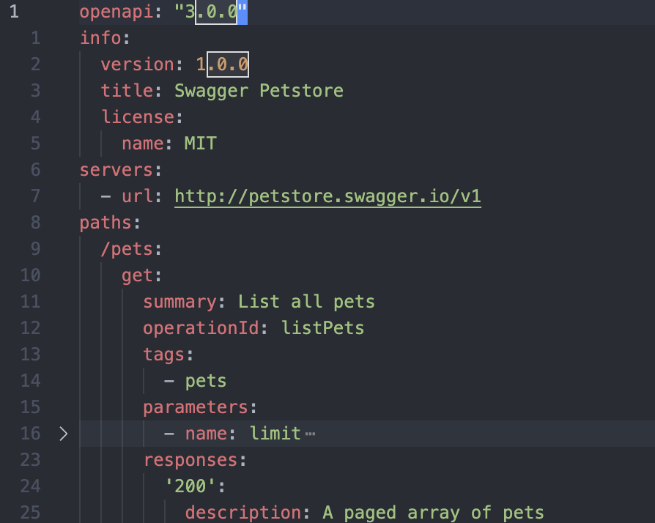
Terms - OpenAPI specification
Definition formats: JSON, YAML
Definition versions: 2.0, 3.0, 3.1

Slide 4
Problem
Existing code generation solutions demonstrate good performance in common languages like Python. Their performance in more narrow-purpose languages like OpenAPI or GraphQL is less than satisfactory.
OpenAPI generation can’t be evaluated using existing natural language or code generation methods. Developing an evaluation framework would stimulate improvement of solutions in this field.

Slide 5
Existing evaluation methods
Machine translation metrics:
BLEU
METEOR
Levenshtein distance
Code generation metrics

Slide 6
Evaluation framework. Metrics
Correctness - how often the generated OpenAPI definition is semantically identical to the original one.
Validity - how often the generated OpenAPI definition is syntactically valid.
Speed - how fast the solution generates the OpenAPI definition.

Slide 7
Evaluation framework. Implementation
Automated evaluation framework
100 randomly selected 10-line snippets are masked from 10 definitions
Semantic OpenAPI difference is considered during evaluation.
Invalid result == test failed
Significant difference == test failed
Insignificant difference:
Description changed
Example changed (structure is the same)

Slide 8
Evaluation framework - Definitions
Criterias for definitions for the evaluation framework
Most recent definitions
Not found in The Stack dataset
Human-written
3,000+ lines. Preferring 20,000+ lines
Different fields
Different companies

Slide 9
Solution prototype. Platforms and tools
Foundational model - Code Llama from Meta
Infrastructure platform - Hugging Face Inference Endpoints
Client-side programming language - JavaScript

Slide 10
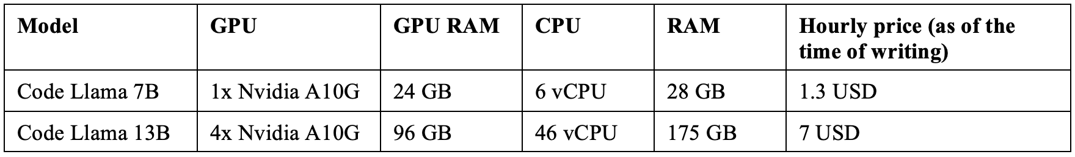
Results. Hardware used

Slide 11

Results. GitHub Copilot
Results
Correctness: 29%
Validity: 68%
Speed: 19 char/s

Slide 12
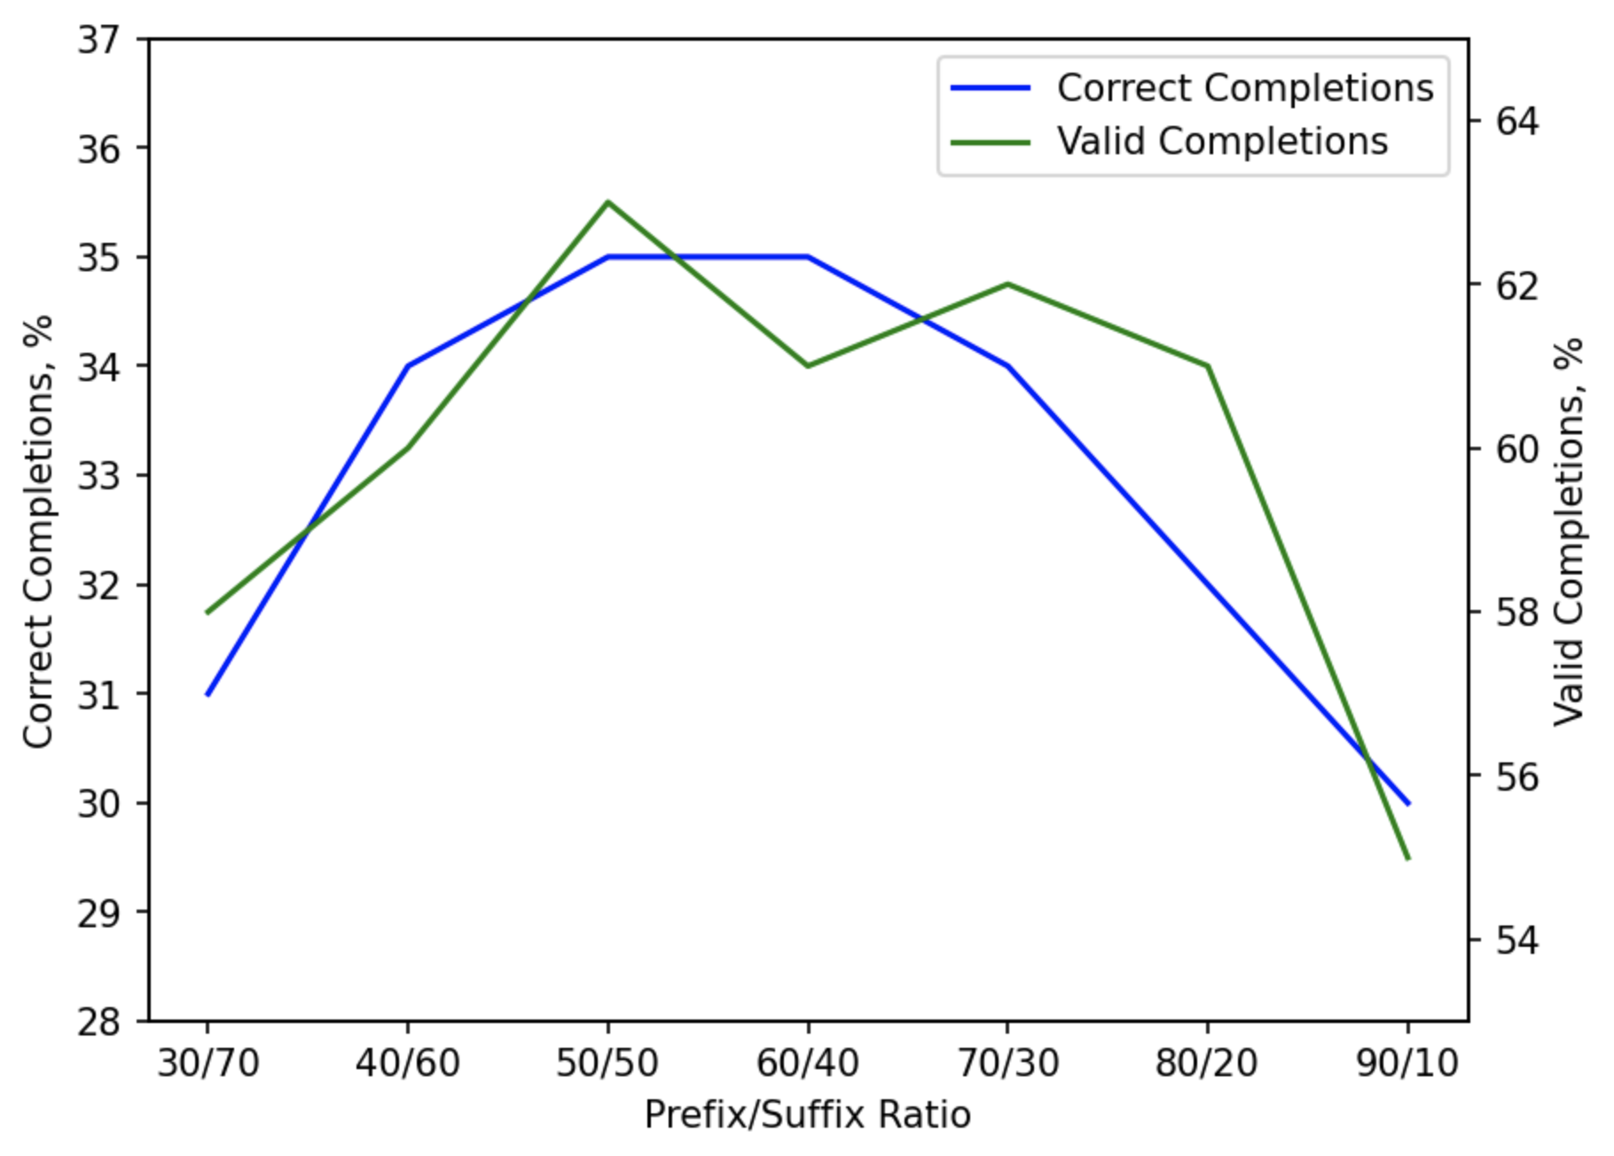
Results. Optimal prefix-to-suffix ratio
Optimal ratio: 50/50
Results:
Correctness: 36%
Validity: 61%
Speed: 81 char/s

Slide 13
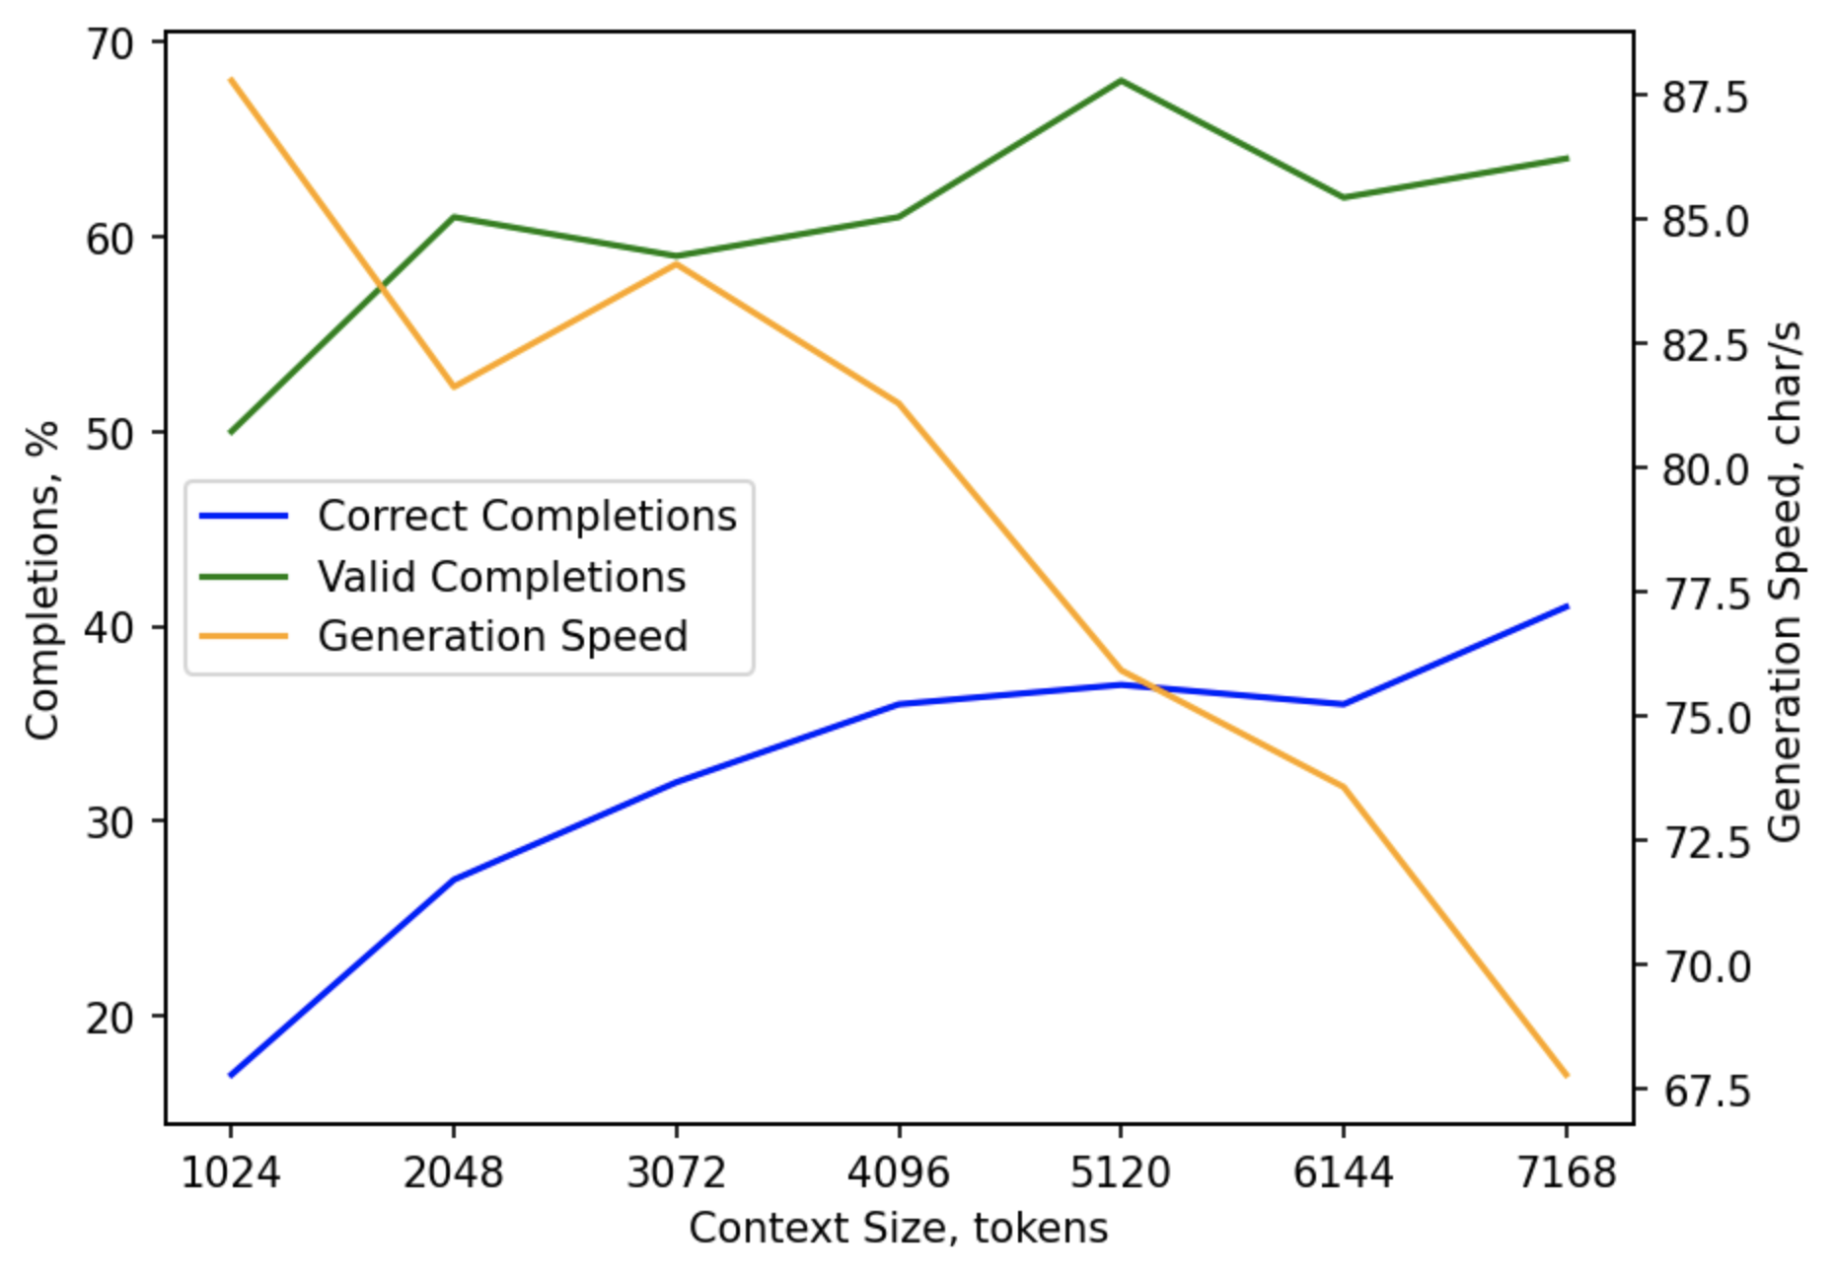
Results. Optimal context size
Optimal size: 4096 tokens
Results:
Correctness: 36%
Validity: 61%
Speed: 81 char/s
Best:
Correctness: 41%
Validity: 64%
Speed: 67 char/s

Slide 14
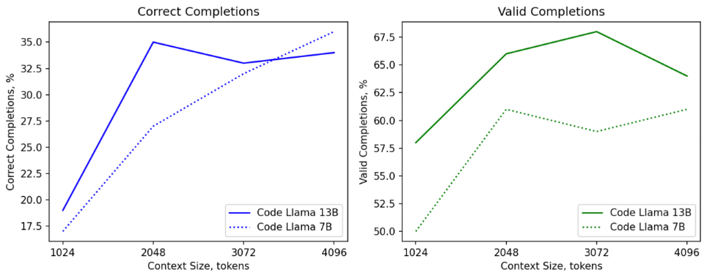
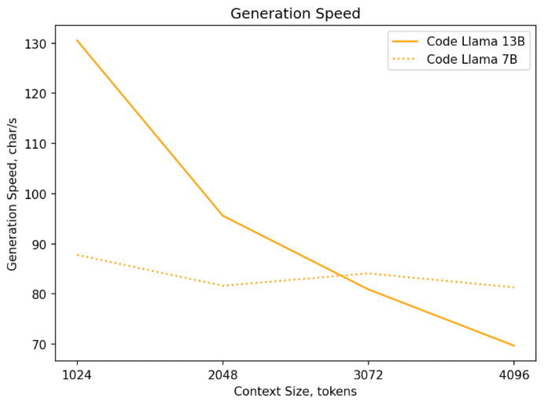
Results. Optimal model sie

Slide 15
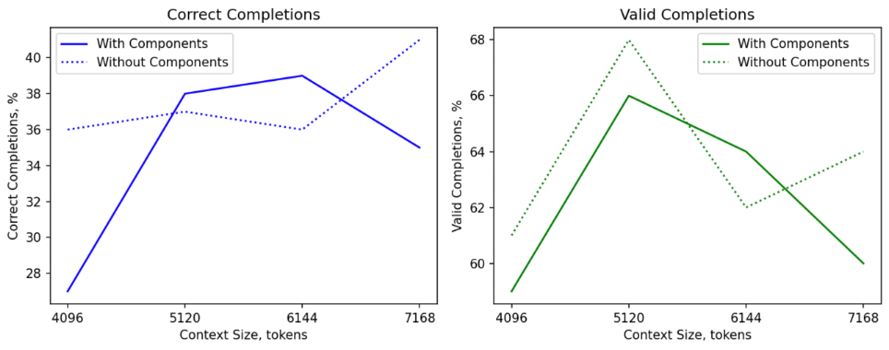
Results. OpenAPI metadata in prompt

Slide 16
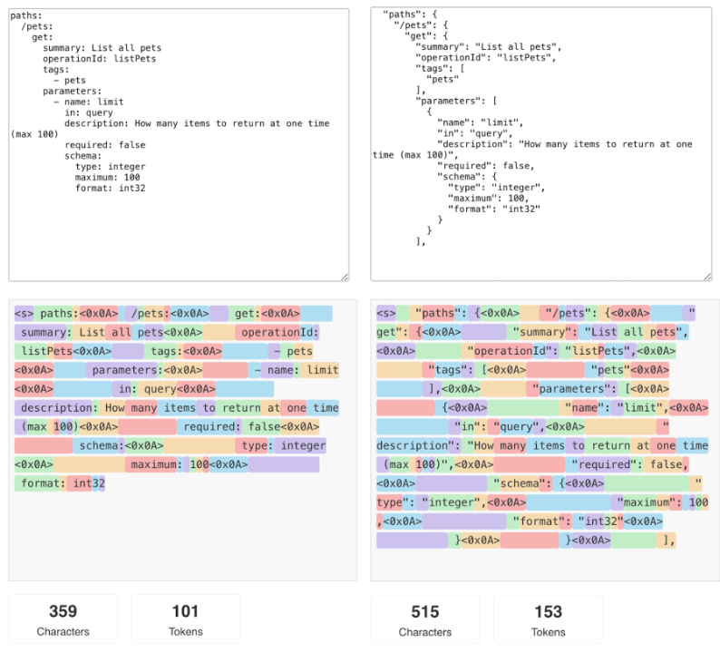
Results. YAML vs JSON
Results:
Correctness: 27% (-8%)
Validity: 56% (-5%)
Speed: 72 char/s (-11%)
JSON vs YAML size:
Characters: + 43.5%
Tokens: 51.5%

Slide 17
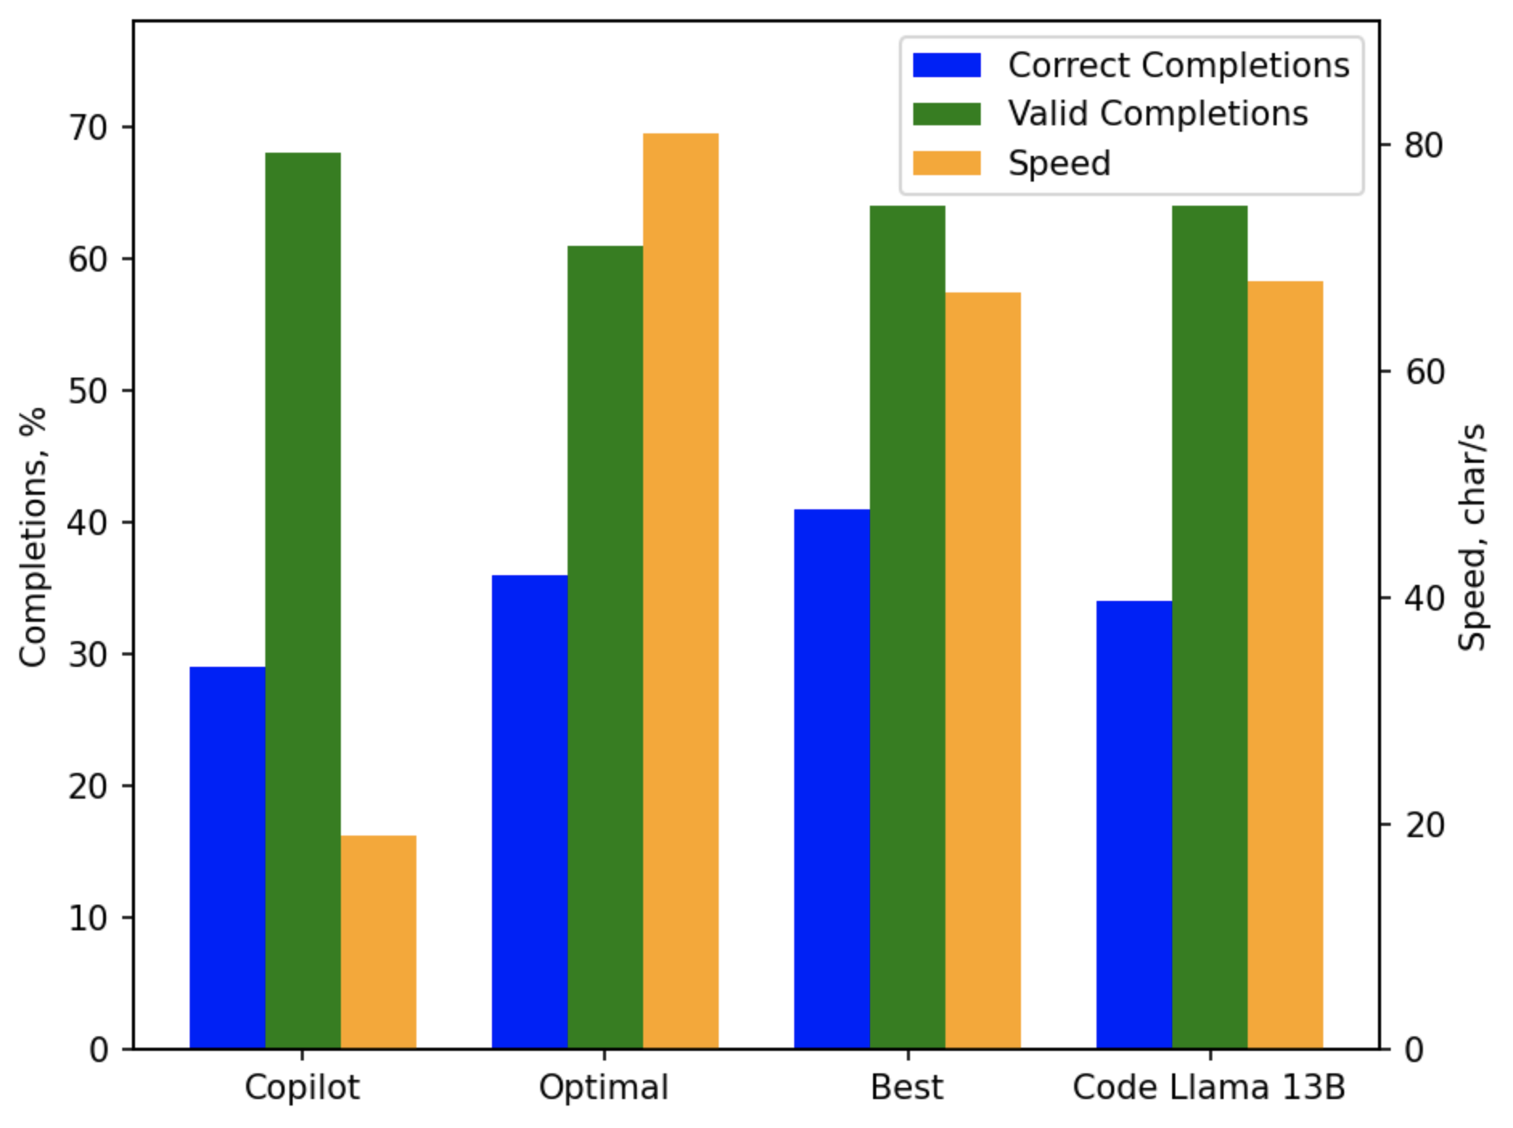
Results. Comparison

Slide 18
Next steps
Code Llama fine tuning
Most of the definitions were already used for training
Dataset size >>> Learned parameters size
Build VSCode extension prototype
Would help to evaluate usability

